Slide 1
Overview of Dreamquark
Alexandre CAMERON
SAGEX, 30th of July 2019

Slide 2
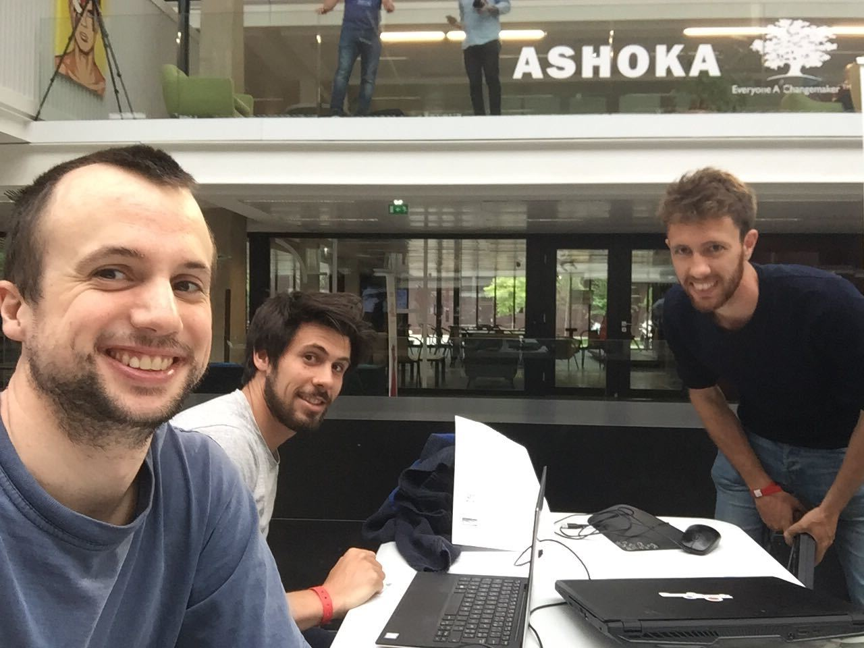

Who am I ?
Seb, Quentin and I
My avatar on slack, git etc.
PhD in physics Turbulence theory and DNS
Data scientist at Dreamquark:
Engage in customer project (40%)
Develop new functionalities (40%)
Survey python framework, kaggle competition, article (20%)

Slide 3
Who we are ?

Slide 4
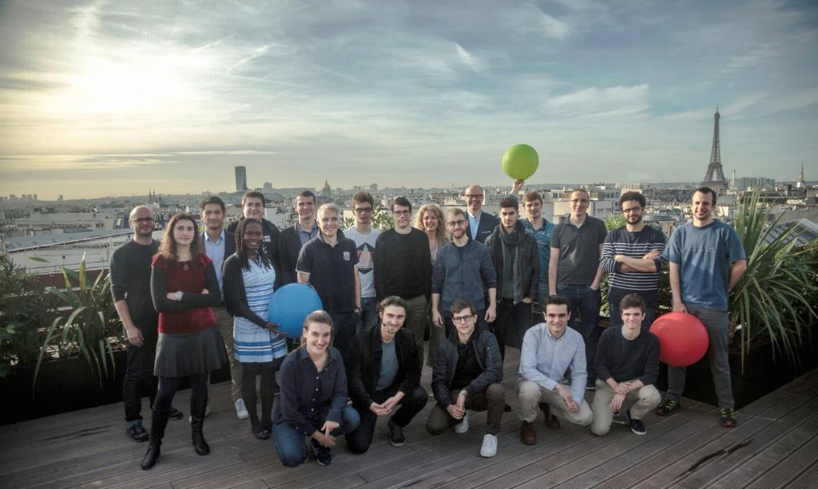
The success of a team
Now a team of
30
inc 8 PhD
François de Lescure
Chief Sales & Marketing
Georges Destriau
CFO
Pierre Besson
Chief Technology Officer
Camille Morel
Chief Customer Officer
Nicolas Meric
CEO
Jeremie Abiteboul
Chief Product & Research Officer
Series-B

Slide 5
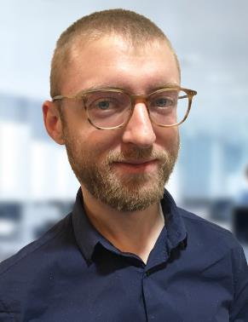
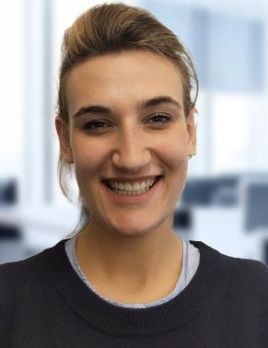
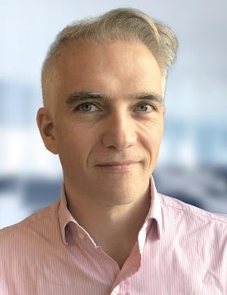
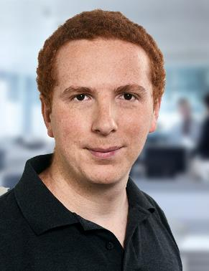
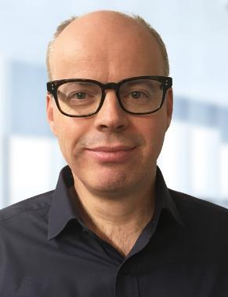
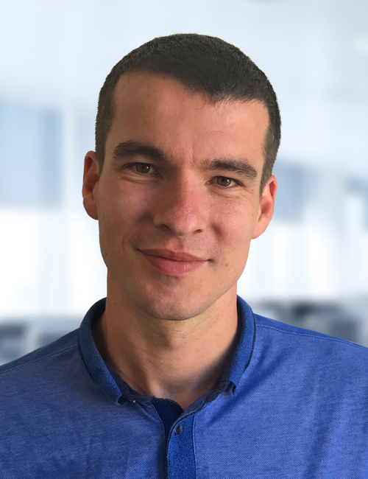
4 pillars around customers and technology
From a wealth of expertise and expérience,
our team constantly challenge itself to provide companies with the best product
Nicolas MERIC
Founder-Chief Executive Officer
PhD in particle physics
Camille MOREL
Chief Customer Officer
EMLYON, LSE
François de LESCURE
Chief Sales & Mkg Officer
INSEAD, Centrale Nantes
Jérémie ABITEBOUL
Chief Product & Research Officer
Mines Paris, PhD in nuclear physics
Georges Destriau
Chief Financial Officer
EMLYON
Pierre Besson
Chief Technology Officer,
Télécom ParisTech

Slide 6
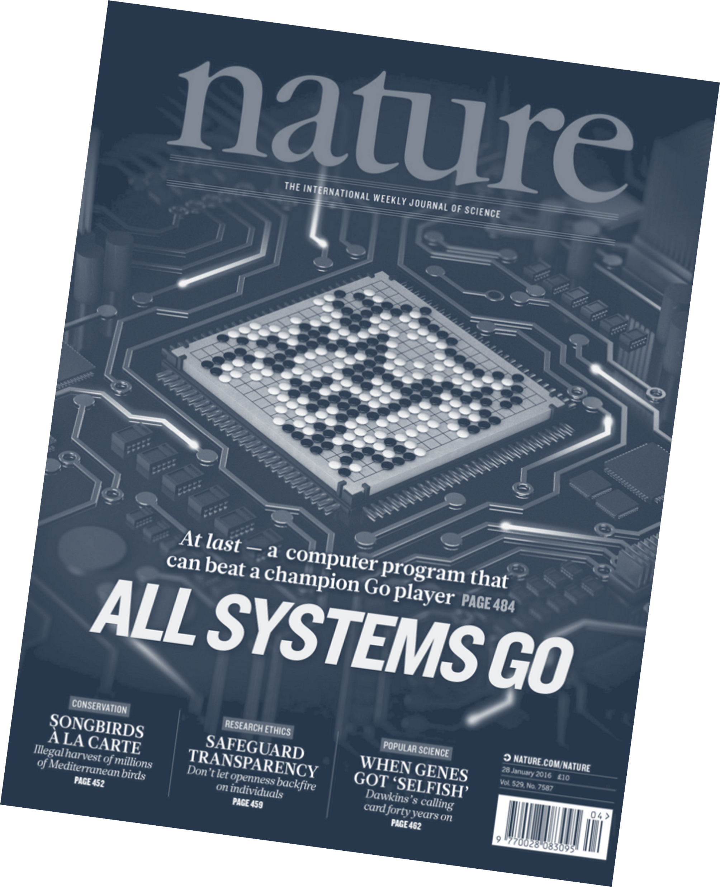





Transparency of decisions
Ability to do more business
Ease of use
Ease of deployment

Slide 7
What do we sell ?

Slide 8



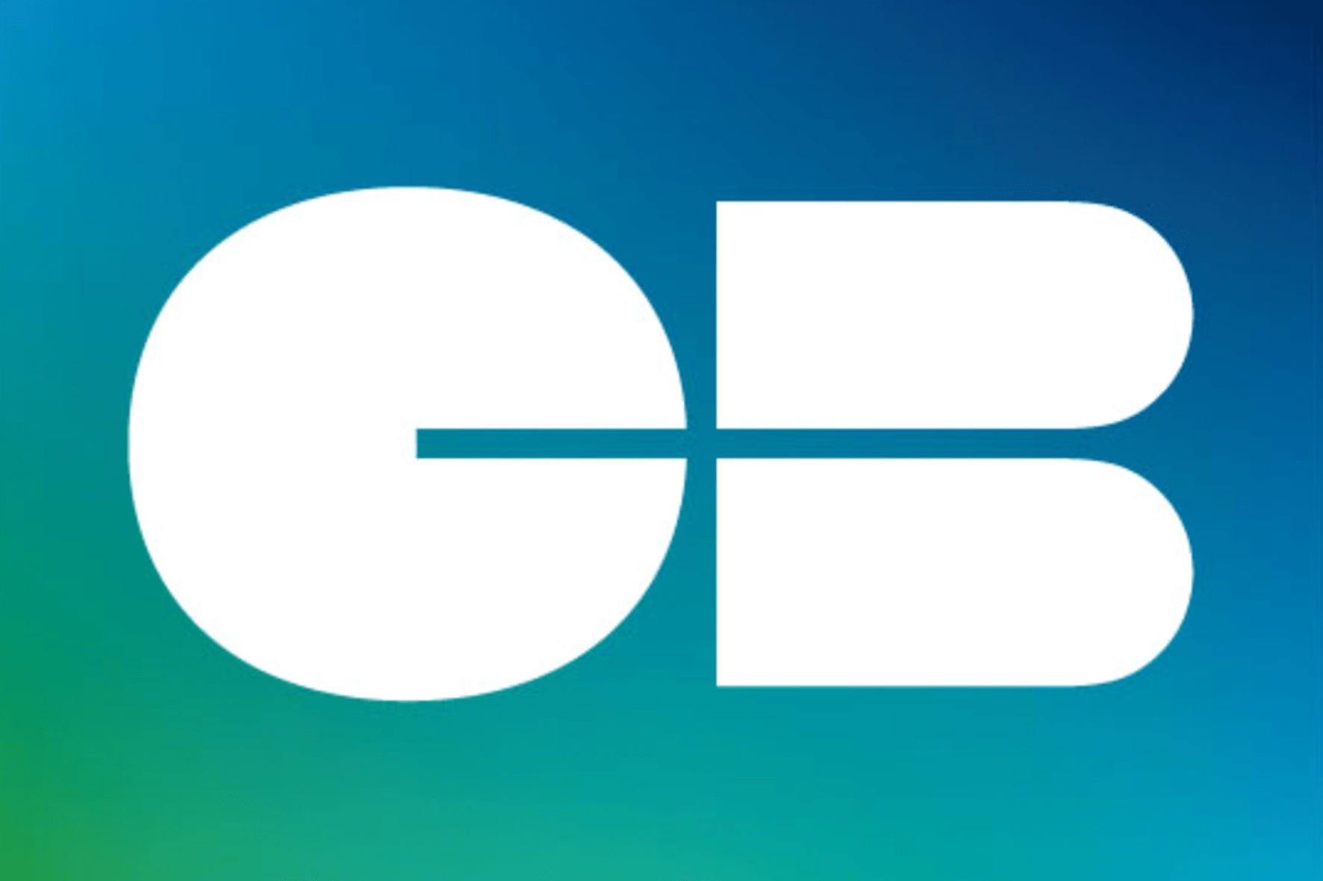



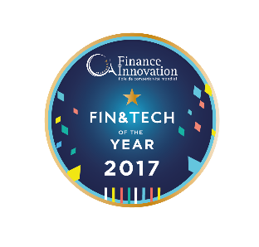




DreamQuark software helps Financial Services profitability
THEY
TRUST
US
RECENT
AWARDS

Slide 9
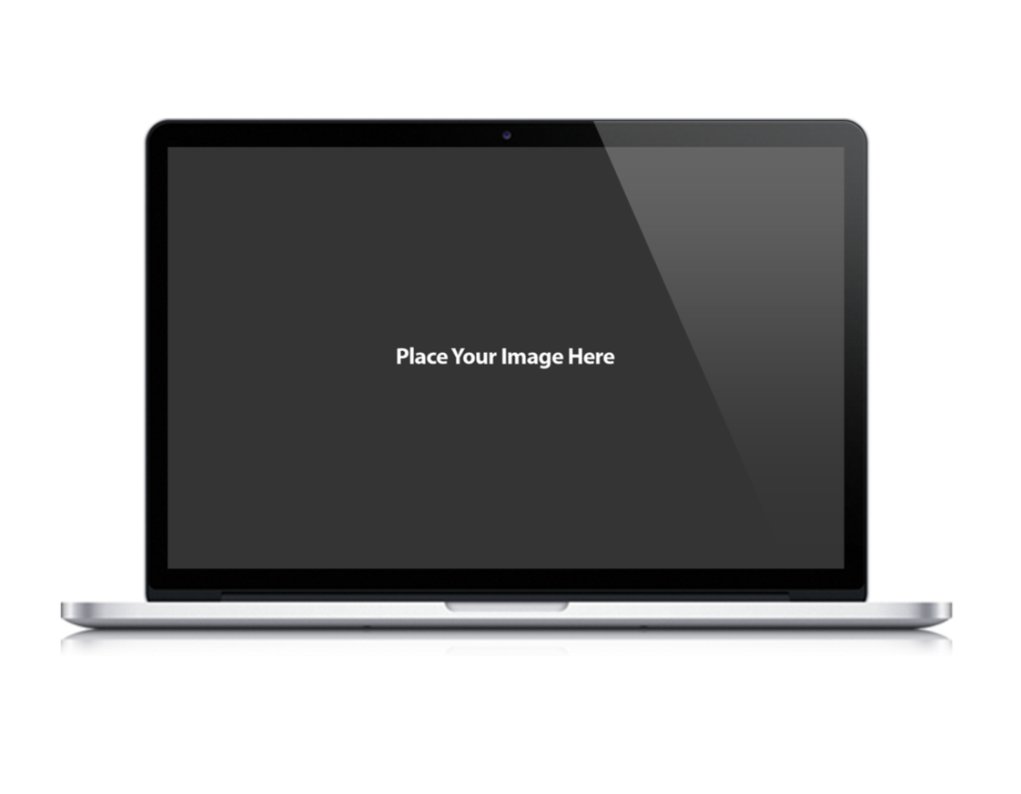
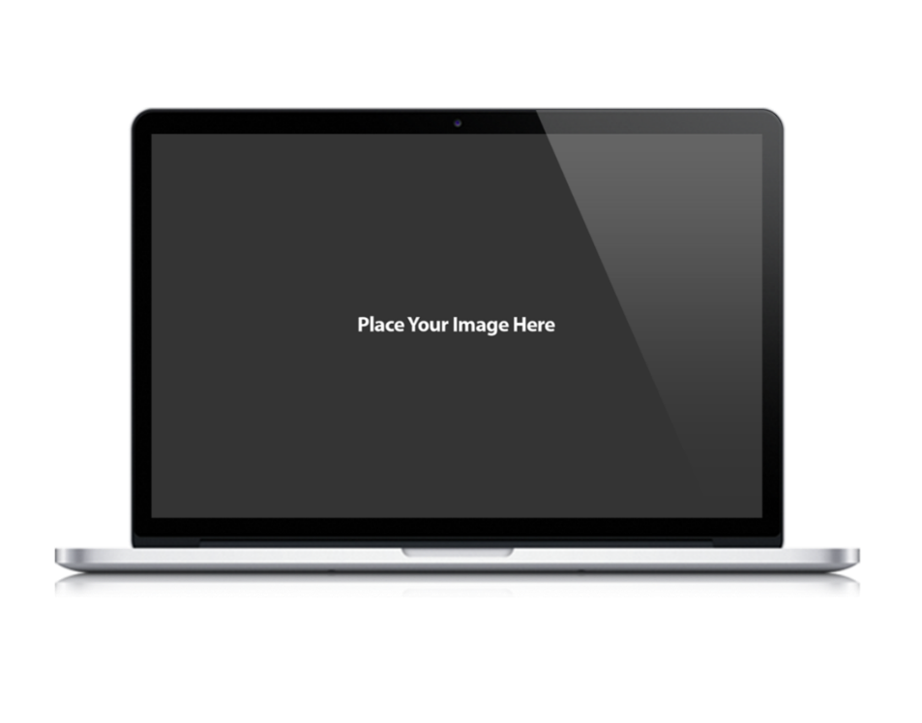
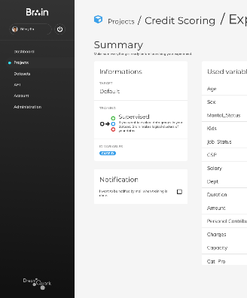
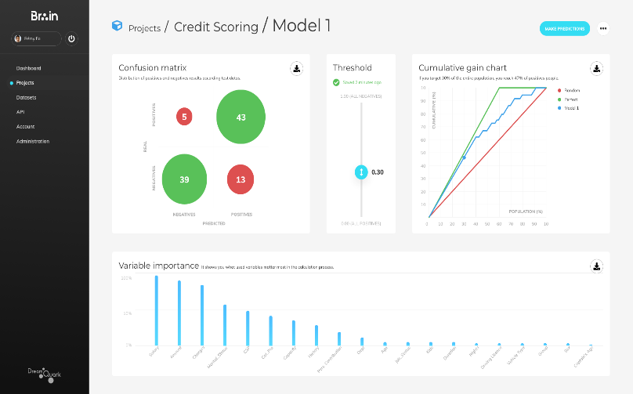
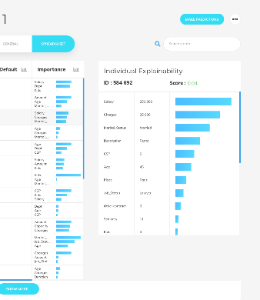
Brain value proposition for Financial Services
Data-science
Trustworthy AI
Unmatched algorithm accuracy
Impressive business returns
Ultra-personalized decisions
Decisions individually explained
First white-box deep learning
Business users
Regulators
Inclusive user interface
Connectors for business users
Audit trail, reports, model quality & governance mechanisms
Compliance with regulator
Enterprise & Security
Devops
Made for global banks & Insurances
Multi-tenant
Secured
One click deployment
Multi-cloud, on prem & hybrid
Model drift monitoring

Slide 10




Leveraging accumulated data can boost profitability
To make it a reality in large scale production, DreamQuark created an AI platform for business experts:
Simple & zero-code
Enterprise grade IT
Top data-driven decisions
On-prem or SaaS
Multi-tenant
Transparent & trustworthy
Learn & Model
Deploy Docker Model
Ingest Data
Select Model
Enrich Existing Marketing & Risk App

Slide 11








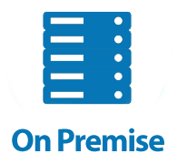






Brain, the AI industrial software for Banks & Insurances
1 |
2 |
MODEL DEPLOYMENT
Example of ROI
LEVERAGE Historical data
RISK
Scoring
Fraud
Fragile clients
Recovery
45% fraud detected
Low credit reject
Training Platform
Scoring API
MODEL SELECTION
MARKETING
DATA
PROCESSING
API MODEL DEPLOYMENT
Upsell/cross-sell
Segmentation
Reco
Churn
3x more engagement
4x more deals
A
API
DATA
AI ALGORITHM
B
COMPLIANCE
API CALLS
AML
CFT
Compliance
Audit
- 60% false alert
All suspicious found
C
TENANT 1
TENANT 2
TENANT 3
Multi-tenant
Multi-cloud

Slide 12
What happens in real life ?

Slide 13
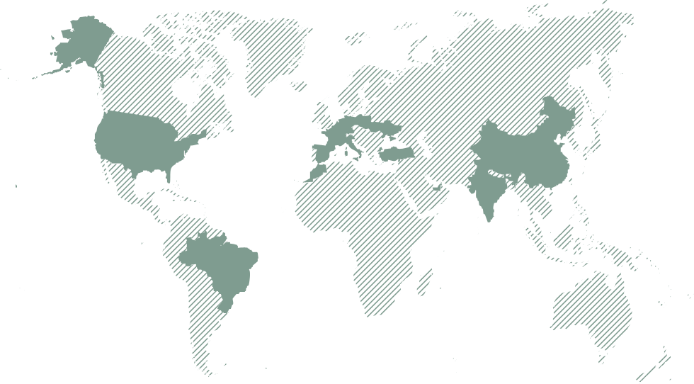
Some marketing use cases examples and gains
Transparency of decisions
Next Best Offer
More engagement
4X
3X
Deal conversions
New cash prediction
>500 M
Detected on 179 targets customer
Ease of use
Advisory propensity
+70%
Detected target for the same reach effort
Advisory attrition
Detected churners in a pool of 100 clients
>50%
Ease of deployment
Ability to do more business

Slide 14
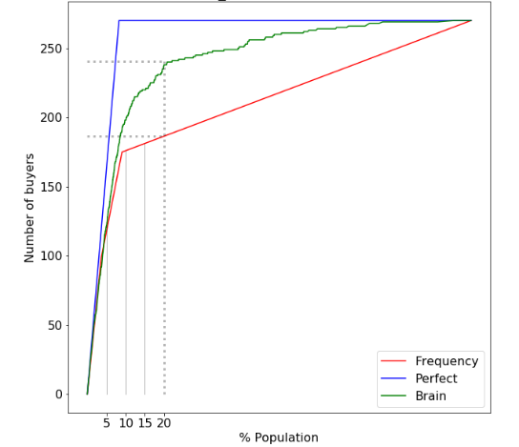
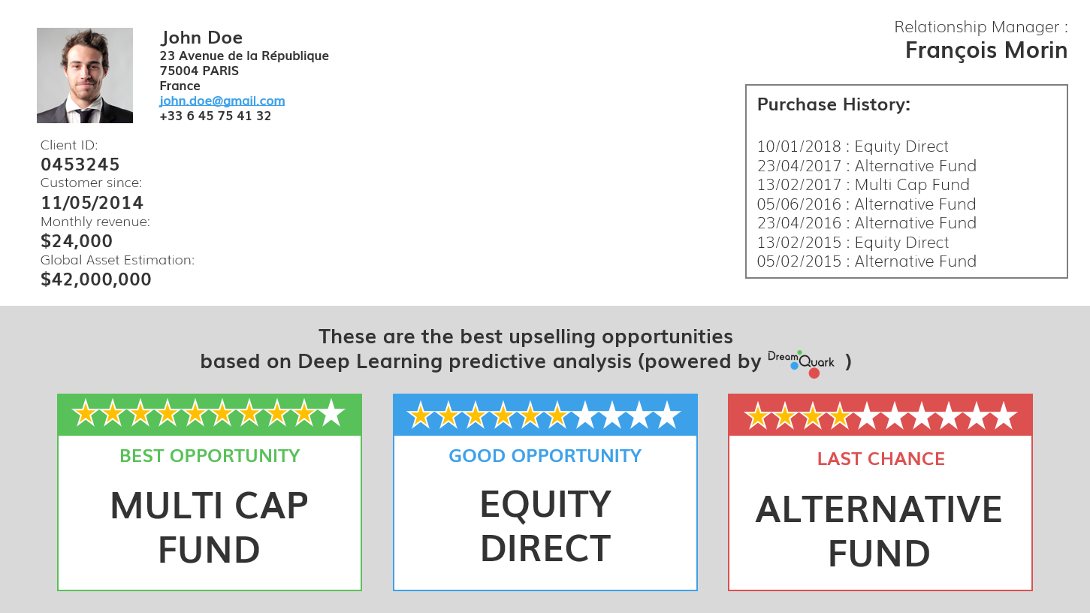
Marketing - Upsell wealth product
CHALLENGE
Detect wealthy clients propensity for value-added products and engage on the opportunity
Transparency of decisions
SIMPLE
Recognize active clients from historical data with deep learning and target similar ones
Skills competence to marketers in using autonomously the platform
Ease of use
EXPLICABLE
Explain relevant drivers of product propensity for each individual
Match insights with ongoing product campaigns to generate account activity
PERFORMANT
Create & validate 9 models in 1 month
Limited population
Shift from a product-view to a customer-view
Ease of deployment
Ability to do more business

Slide 15
AI journey & business model with DreamQuark
DQ data science & IT support and skills transfer
MVP productization
Production
User licence
Prediction volume fee
Customer success
MVP creation & quick integration
Field ROI measurement
Platform adoption by business experts
IT & security validation
Scoping
Data export
2-9 months
Multi-years

Slide 16
Building and deploying a model : general planning example
Pilot
start
Theoritical Gains
Practical Gains
1. Scoping
2. Pilot
3. Valid (out of scope) Use of the model by client teams
Iterations on the model for production
IT Qualification (out of scope) Elements for the deployment committee
Preparation of the architecture, security committees
4. Deployment (out of scope)
5. Stream legal & purchase
NDA, DPO, contract, legal, negociations Meeting with other client teams and use case identifications
M0
M3
M6

Slide 17
Pilot preparation steps example
NDA
UC & data candidate
Data WS/sample
UC feasibility
Pilot offer
GO sponsor
Pilot
start
UC identification & production strategy
DQ UC pre-qualification
DQ UC feasibility
DQ Offer
Client Admin
NDA
Client Admin
DPO data review & exec GO
Client admin
PO or contract signing
Client IT prerequisites (as required)
Client data extract
DQ Security questionnaire
User accounts creation
M0
M0,5
M1,5
M2
M3
M4

Slide 18
Demo

Slide 19
Thank You
Alexandre CAMERON
alexandre.cameron@dreamquark.com
Jérémie ABITEBOUL
jeremie.abiteboul@dreamquark.com

